Slide 1

EditEdit MasterMaster texttext stylesstyles
Practical Lecture : Pointers

Slide 2

Quick Recap
Let’s take a quick recap of previous lecture –
A) Friend Function
B) Friend Class
C) Call by value
D) Call by reference
E) Call by Address
F)Recurssion

Slide 3
Today’s Agenda
Today we are going to cover -
Pointers
Difference b/w pointers and reference variables
Void pointer
Pointer to Pointer

Slide 4
C++
Let’s Get Started-

Slide 5
Pointers
Pointer is a variable in C++ that holds the address of another variable. They have data type just like variables, for example an integer type pointer can hold the address of an integer variable and an character type pointer can hold the address of char variable.
Syntax:-
data_type *pointer_name;
int *p, var
As I mentioned above, an integer type pointer can hold the address of another int variable. Here we have an integer variable var and pointer p holds the address of var. To assign the address of variable to pointer we use ampersand symbol (&).
p = &var;

Slide 6
Pointers
#include <iostream>
using namespace std;
int main(){
//Pointer declaration
int *p, var=101;
//Assignment
p = &var;
cout<<"Address of var: "<<&var<<endl;
cout<<"Address of var: "<<p<<endl;
cout<<"Address of p: "<<&p<<endl;
cout<<"Value of var: "<<*p;
return 0;
}

Slide 7
Output
Address of var: 0x7fff5dfffc0c
Address of var: 0x7fff5dfffc0c
Address of p: 0x7fff5dfffc10
Value of var: 101

Slide 8
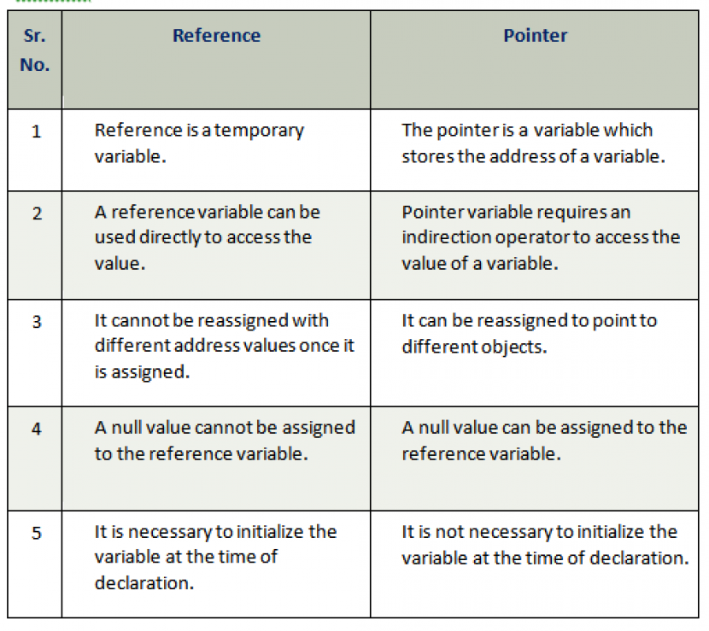
Difference b/w pointers and reference variable

Slide 9
Void Pointers
A void pointer is a general-purpose pointer that can hold the address of any data type, but it is not associated with any data type.
void *ptr;

Slide 10
Void Pointers
#include <iostream>
using namespace std;
int main()
{
void *ptr; // void pointer declaration
int a=9; // integer variable initialization
ptr=&a; // storing the address of 'a' variable in a void pointer variable.
std::cout << &a << std::endl;
std::cout << ptr << std::endl;
return 0;
}

Slide 11
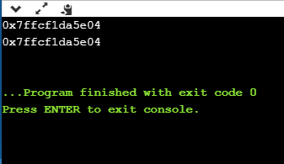
Output

Slide 12
Arithmetic Pointer
A pointer is an address which is a numeric value; therefore, you can perform arithmetic operations on a pointer just as you can a numeric value.

Slide 13
Incrementing a Pointer
#include <iostream>
using namespace std;
const int MAX = 3;
int main () {
int var[MAX] = {10, 100, 200};
int *ptr;
ptr = var;
for (int i = 0; i < MAX; i++) {
cout << "Address of var[" << i << "] = ";
cout << ptr << endl;
cout << "Value of var[" << i << "] = ";
cout << *ptr << endl;
ptr+; }
}

Slide 14
Output
Address of var[0] = 0xbfa088b0
Value of var[0] = 10
Address of var[1] = 0xbfa088b4
Value of var[1] = 100
Address of var[2] = 0xbfa088b8
Value of var[2] = 200

Slide 15
Decrementing a Pointer
#include <iostream>​
​using namespace std;​
const int MAX = 3;​
​
int main () {​
int var[MAX] = {10, 100, 200};​
int *ptr;​
ptr = &var[MAX-1];​
​for (int i = MAX; i > 0; i--) {​
cout << "Address of var[" << i << "] = ";​
cout << ptr << endl;​
​ cout << "Value of var[" << i << "] = ";​
cout << *ptr << endl;​
ptr--;​
}​}
​

Slide 16
Decrementing a Pointer
Address of var[3] = 0xbfdb70f8
Value of var[3] = 200
Address of var[2] = 0xbfdb70f4
Value of var[2] = 100
Address of var[1] = 0xbfdb70f0
Value of var[1] = 10
​

Slide 17
Pointer Comparisons
Pointers may be compared by using relational operators, such as ==, <, and >. If p1 and p2 point to variables that are related to each other, such as elements of the same array, then p1 and p2 can be meaningfully compared.
#include <iostream>
using namespace std;
const int MAX = 3;

Slide 18
Pointer Comparisons
int main () {
int var[MAX] = {10, 100, 200};
int *ptr;
ptr = var;
int i = 0;
while ( ptr <= &var[MAX - 1] ) {
cout << "Address of var[" << i << "] = ";
cout << ptr << endl;
cout << "Value of var[" << i << "] = ";
cout << *ptr << endl;
ptr++;
i++;
}
}

Slide 19
Output
Address of var[0] = 0xbfce42d0
Value of var[0] = 10
Address of var[1] = 0xbfce42d4
Value of var[1] = 100
Address of var[2] = 0xbfce42d8
Value of var[2] = 200

Slide 20
Pointer to Pointer
We already know that a pointer points to a location in memory and thus used to store the address of variables. So, when we define a pointer to pointer. The first pointer is used to store the address of the variable. And the second pointer is used to store the address of the first pointer. That is why they are also known as double pointers.
Declaration:-
int **ptr;

Slide 21
Pointer to Pointer
#include<iostream>
using namespace std;
int main()
{
int var = 789;
int *ptr2;
int **ptr1;
ptr2 = &var;
ptr1 = &ptr2;
cout<< var<<endl;
cout<<*ptr2<<endl ;
cout<<**ptr1;
}

Slide 22
Output
789
789
789

Slide 23

QNA Time
    Any Questions??
Any Questions ??

Slide 24
Thank You!
See you guys in next class.

